Slide 1



Find Doctor
By: Arwa Al-Shammari , Rawan Al-Maimony
Razan Al-Mutairi , Amal Al-Shammari
Amjad Al-Shammari , Maram Al-Anazi
Supervisor: Dr. Basma
may 4, 2024

Slide 2

Outline
Foreword
Background
Research Problem
Contribution
Related Work
Design and Implementation
Results
Conclusion
Future Work

Slide 3
Outline
Foreword
Acknowledgements
Biographical Highlights
Background
Research Problem
Contribution
Related Work
Design and Implementation
Results
Conclusion
Future Work

Slide 4
Acknowledgements
In the first place, we wish to state our thanks to Allah for the strength and the help that gave us to complete the graduation project.Secondly, we like to declare our warm thanks to Dr. Basma omar.
Furthermore, we are grateful to the university of Hafr Al- Batin for the opportunity given to us to learn new concepts in teamwork and communication skills.
In the end, we would like to thank our team members for their good dealings, taking responsibility, and cooperating with each other.

Slide 5
introduction
The goal of this project is to develop a web-based solution that will serve as a comprehensive physician search management tool. The site is designed to enhance the search for a doctor because it is one of the most important problems facing patients: how to find a serious doctor with a good reputation and good experience in dealing with all of this through the data and information that will be provided to the patient about the patient through the site

Slide 6
Biographical Highlights
Name | Highlights
Rawan | Project Manager, UI designer , Testing engineer
Arwa | UI designer, Testing Engineer, Database designer
Razan | UI designer, Testing Engineer, Database designer
Amal | UI designer, Testing Engineer, Database designer
Amjad | UI designer, Testing Engineer, Database designer
Maram | UI designer, Testing Engineer, Database designer
6
6

Slide 7
Outline
Foreword
Background
Research Problem
Contribution
Related Work
Design and Implementation
Results
Conclusion
Future Work

Slide 8
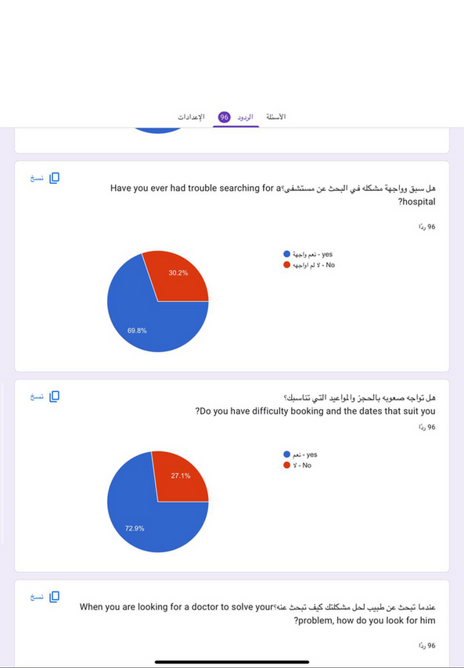
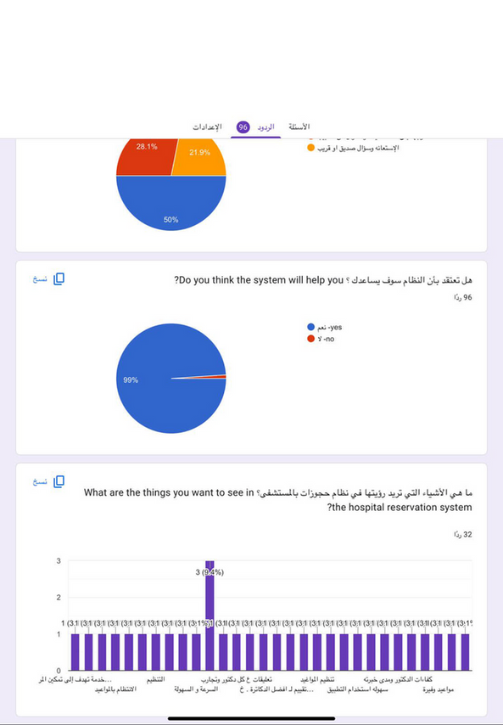
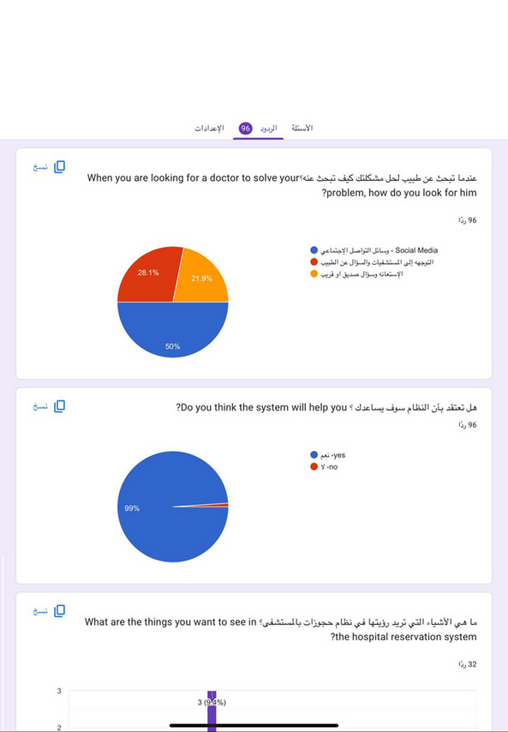
Background
According to the questionnaire that was published, we found the community’s need for a site that helps in finding the appropriate doctor and also makes it quick for users to find and book him. The following pictures show sample questions:

Slide 9
Outline
Foreword
Background
Research Problem
Contribution
Related Work
Design and Implementation
Results
Conclusion
Future Work

Slide 10
Research Problem
The problem of difficulty finding a doctor in a hospital is a common problem faced by many people around the world, and it arises as a result of several factors. Here's a description of this issue:
Increased workload: A small number of doctors may cause increased practical pressure on available doctors, making it difficult to meet patients' needs in a timely manner.
Poor coordination and organization: There may be a lack of coordination between doctors and medical facilities, making it difficult for patients to find the right doctor for their needs.
Technical challenges: Sometimes, there may be technical challenges in contacting doctors or getting information about their schedules and appointments, making it more difficult to find a doctor.

Slide 11
Outline
Foreword
Background
Research Problem
Contribution
Goals
Motivations
Findings
Related Work
Design and Implementation
Results
Conclusion
Future Work

Slide 12
Contribution: Goals
Facilitating access to medical care: The site helps make it easier to find a doctor suitable for the individual health needs of users, reducing the time and effort required by traditional research.
Increase transparency and knowledge: The site can provide detailed information about available doctors, such as their specialties, patient assessments, and work schedules, increasing the transparency of the selection process and helping users make informed decisions.
Providing a diverse and comprehensive service: The site can allow users to search for doctors based on various criteria, such as geographical location, medical specialization, and health insurance, providing multiple and comprehensive options.
Enhance interaction and communication: The site can allow users to communicate directly with doctors, whether through online booking, or sending direct medical inquiries and consultations, which enhances the interaction between doctor and patient.

Slide 13
Contribution: Motivations
Meet the need: You may be familiar with the challenges people face in finding a qualified and suitable doctor easily, and you may want to provide a solution to this problem.
Provide convenience: A doctor search site can make it easier for people to find the medical services they need without the hassle of a long and complex search.
Improving access to healthcare: By providing a centralized platform for searching for doctors, it can contribute to increasing access to health care and improving its quality.
Enhance transparency: By providing comprehensive information about physicians and patient assessments, it can enhance trust and transparency in the healthcare system.
Market expansion: You may see the opportunity to expand into new markets or offer specialized medical services to a wider audience.
Economic benefit: There can be an economic aspect to this project, as you can offer ads or charge doctors or patients to use the platform.

Slide 14
Contribution: Findings
Streamline the search process: The site can provide a simplified search interface that allows users to specify specific criteria such as geographic location, specialization, or patient assessments.
Book appointments: The site can allow patients to book appointments directly with doctors online, saving time and effort for both.
Providing information about medical services:In addition to the doctor's own information, the site may provide information about available medical services, such as examinations, procedures, and treatments.
Patient reviews and ratings: Users can provide ratings and reviews of doctors based on their personal experiences, helping other patients make an informed decision.
Health Guidelines and Resources: The site can provide educational health resources and articles that help patients understand their medical conditions and available treatments.
Quick communication: The site can facilitate communication between patients and doctors via text messages or email, allowing questions to be asked and consultations provided remotely.

Slide 15
Outline
Foreword
Background
Research Problem
Contribution
Related Work
Design and Implementation
Results
Conclusion
Future Work

Slide 16
Related Work
Physician Database: Compile and maintain a comprehensive database that includes information about available doctors and their personal and professional details such as specialties, qualifications, experience, job locations, and working hours.
Advanced Search feature: Provides advanced search feature for users to easily find doctors according to specific criteria such as specialization, geographical location, acceptable health insurance, and more.
Appointment Booking: The site allows users to book their appointments with selected doctors online, providing them with convenience and flexibility in scheduling appointments.

Slide 17
Related Work (cont.)
Physician Rating: The site allows patients to submit ratings and reviews about doctors and their experiences with them, helping others choose the right doctor.
Contact and location information: The site provides contact and location information for each doctor clearly and easily accessible.
Providing medical information: Some sites may offer useful medical content to users such as health tips and medical guidance.

Slide 18
Outline
Foreword
Background
Research Problem
Contribution
Related Work
Design and Implementation
System Design
Implementation
Results
Conclusion
Future Work

Slide 19
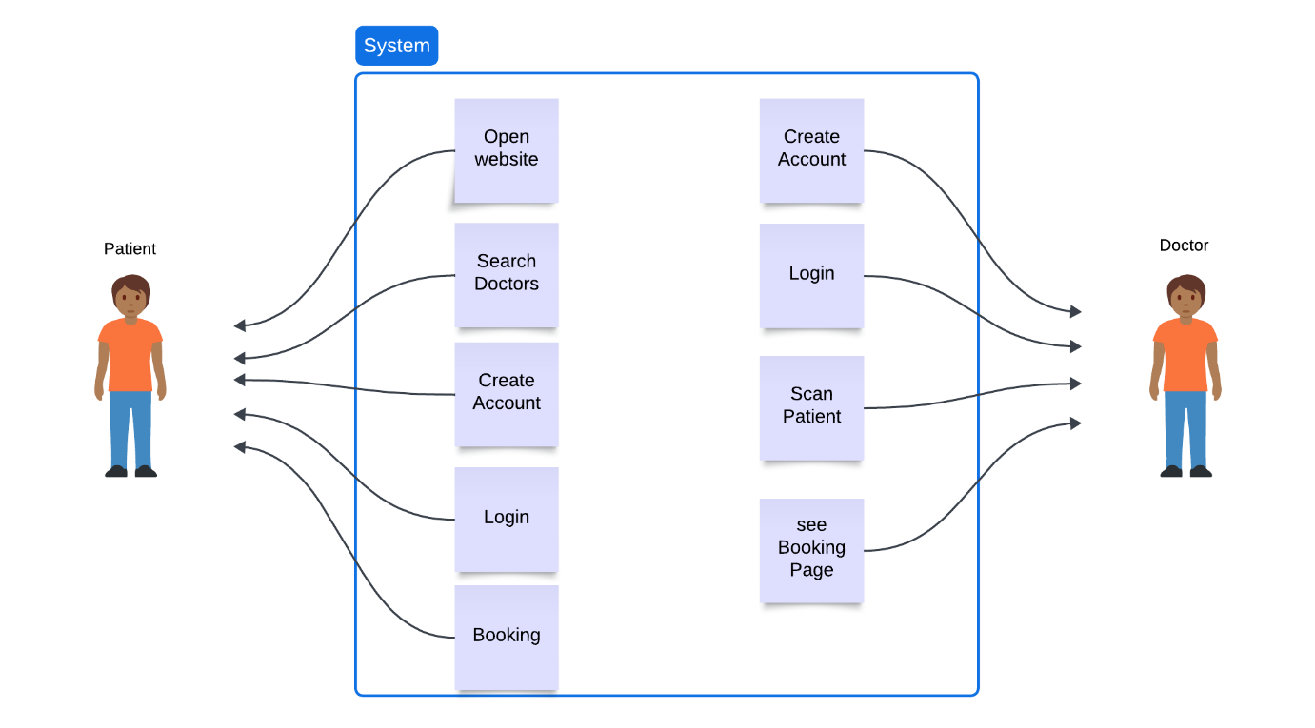
System Design

Slide 20
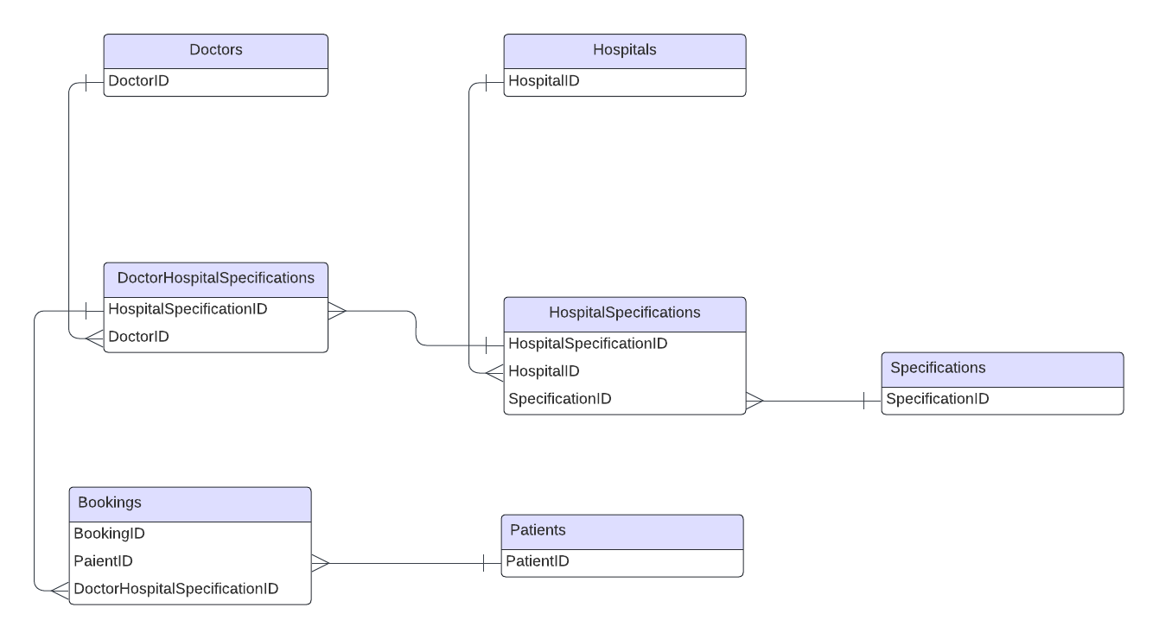
System Design (cont.)

Slide 21
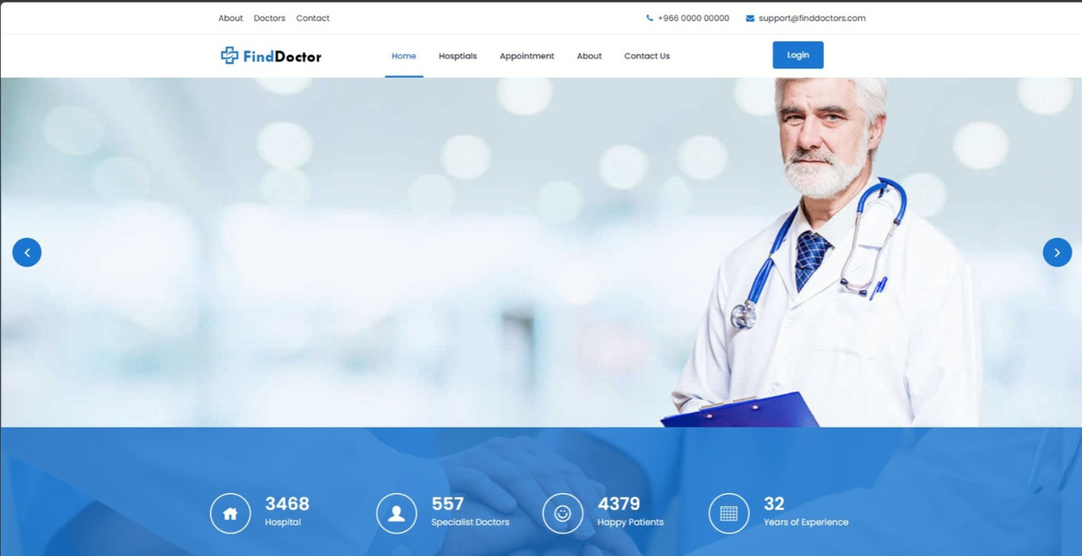
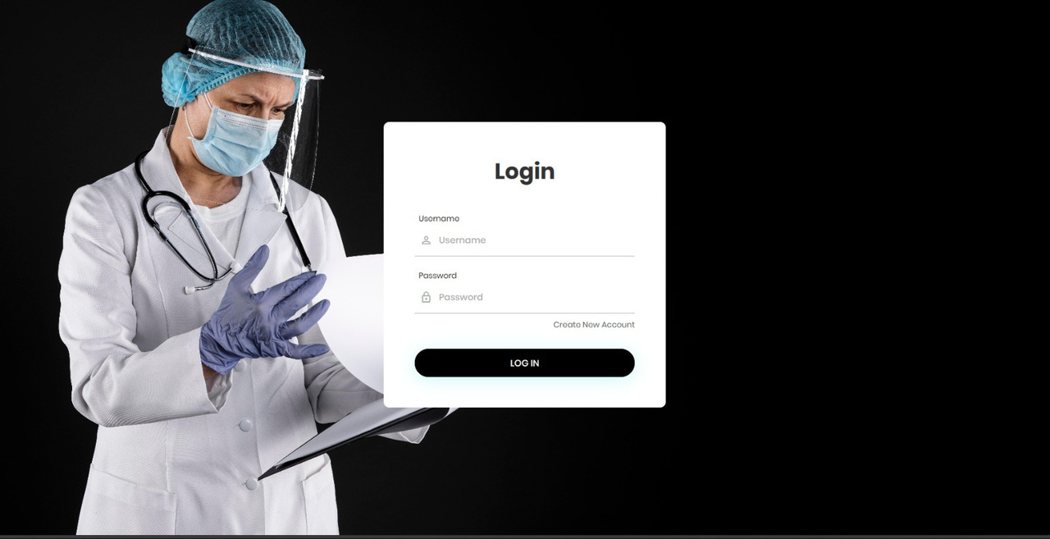
System Implementation

Slide 22
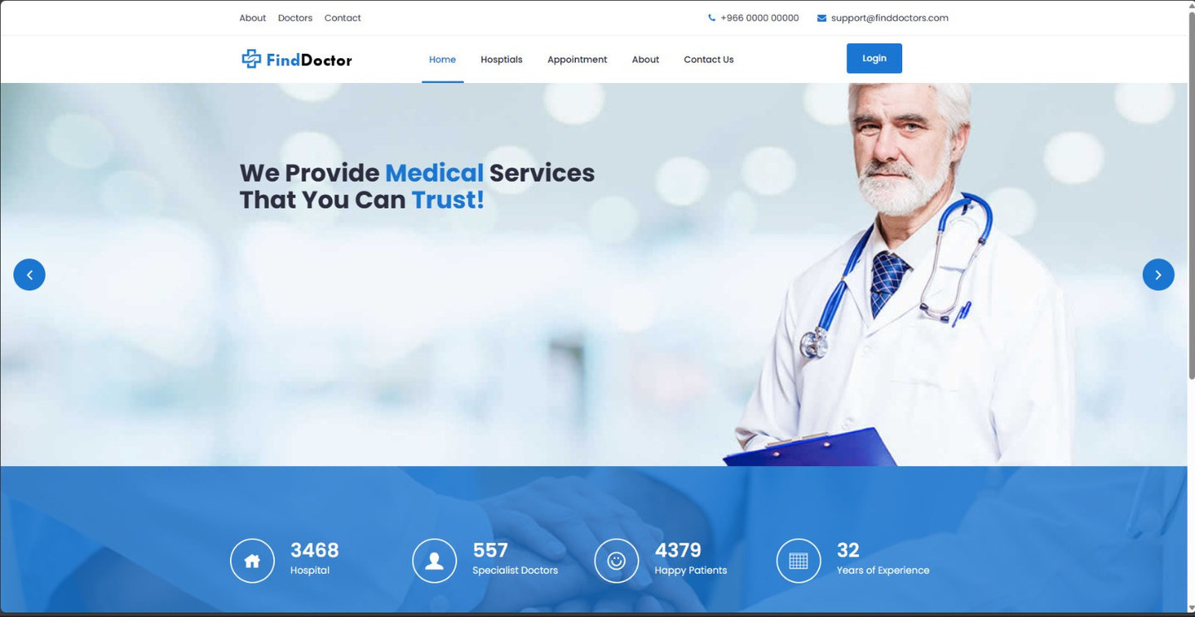
System Implementation (cont.)

Slide 23
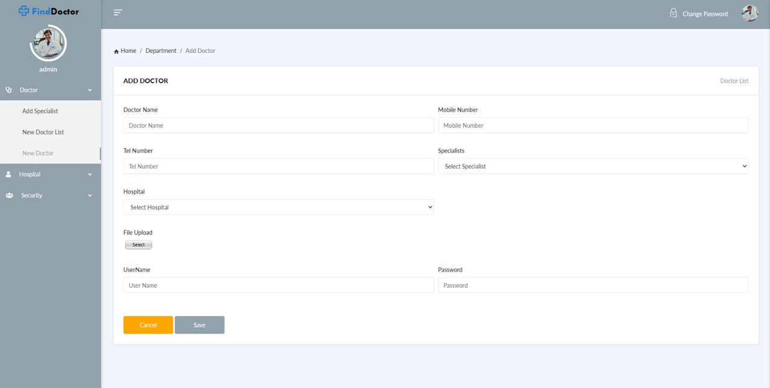
System Implementation (cont.)

Slide 24
Outline
Foreword
Background
Research Problem
Contribution
Related Work
Design and Implementation
Results
Conclusion
Future Work

Slide 25
Results
Personal skills:
Improve the ability of time management.
Working with a team to achieve our goals.
Organizing weekly meetings.
Technical skills: Gain experience in designing Ul with HTML and CSS.
Gain experience in designing the database.
Apply testing methods to the system's design.
Work with web framework ASP.NET

Slide 26
Outline
Foreword
Background
Research Problem
Contribution
Related Work
Design and Implementation
Results
Conclusion
Future Work

Slide 27
Conclusion
In conclusion, the "Find Doctor" project is an innovative step towards improving the healthcare system and facilitating access to medical services. By offering a comprehensive platform that allows patients to find the right doctors easily and effectively, the project contributes to saving time and effort, and enhancing the quality of healthcare. With multiple benefits such as booking appointments online, reading patient reviews, and knowing treatment costs, Find Doctor offers an integrated solution that enhances the user experience and makes healthcare easier and more accessible. This project not only reflects technological advances in health, but also emphasizes the importance of innovation in improving people's lives and ensuring they have access to the medical care they need comfortably and easily.

Slide 28
Outline
Foreword
Background
Research Problem
Contribution
Related Work
Design and Implementation
Results
Conclusion
Future Work

Slide 29
Timetable

Slide 30
In future work We will work to provide better user interfaces that are compatible with a variety of devices and operating systems in our upcoming projects. In addition, we will begin to focus on integrating modern technology, including artificial intelligence, that will boost user numbers and enhance user experiences. We will also create an application that works on mobile operating systems
Future Work

Slide 31
Future Work
We will continue future work on developing user interfaces and applying them to include all hospitals in the world.

Slide 32
References
[1] https://saudi.vezeeta.com/ar
[2] https://altibbi.com/
[3] https://clinido.com/
[4] https://sa.koshofat.com/

Slide 33
Questions
Thank you for your listening
Any questions?

Slide 34

